Slide 1
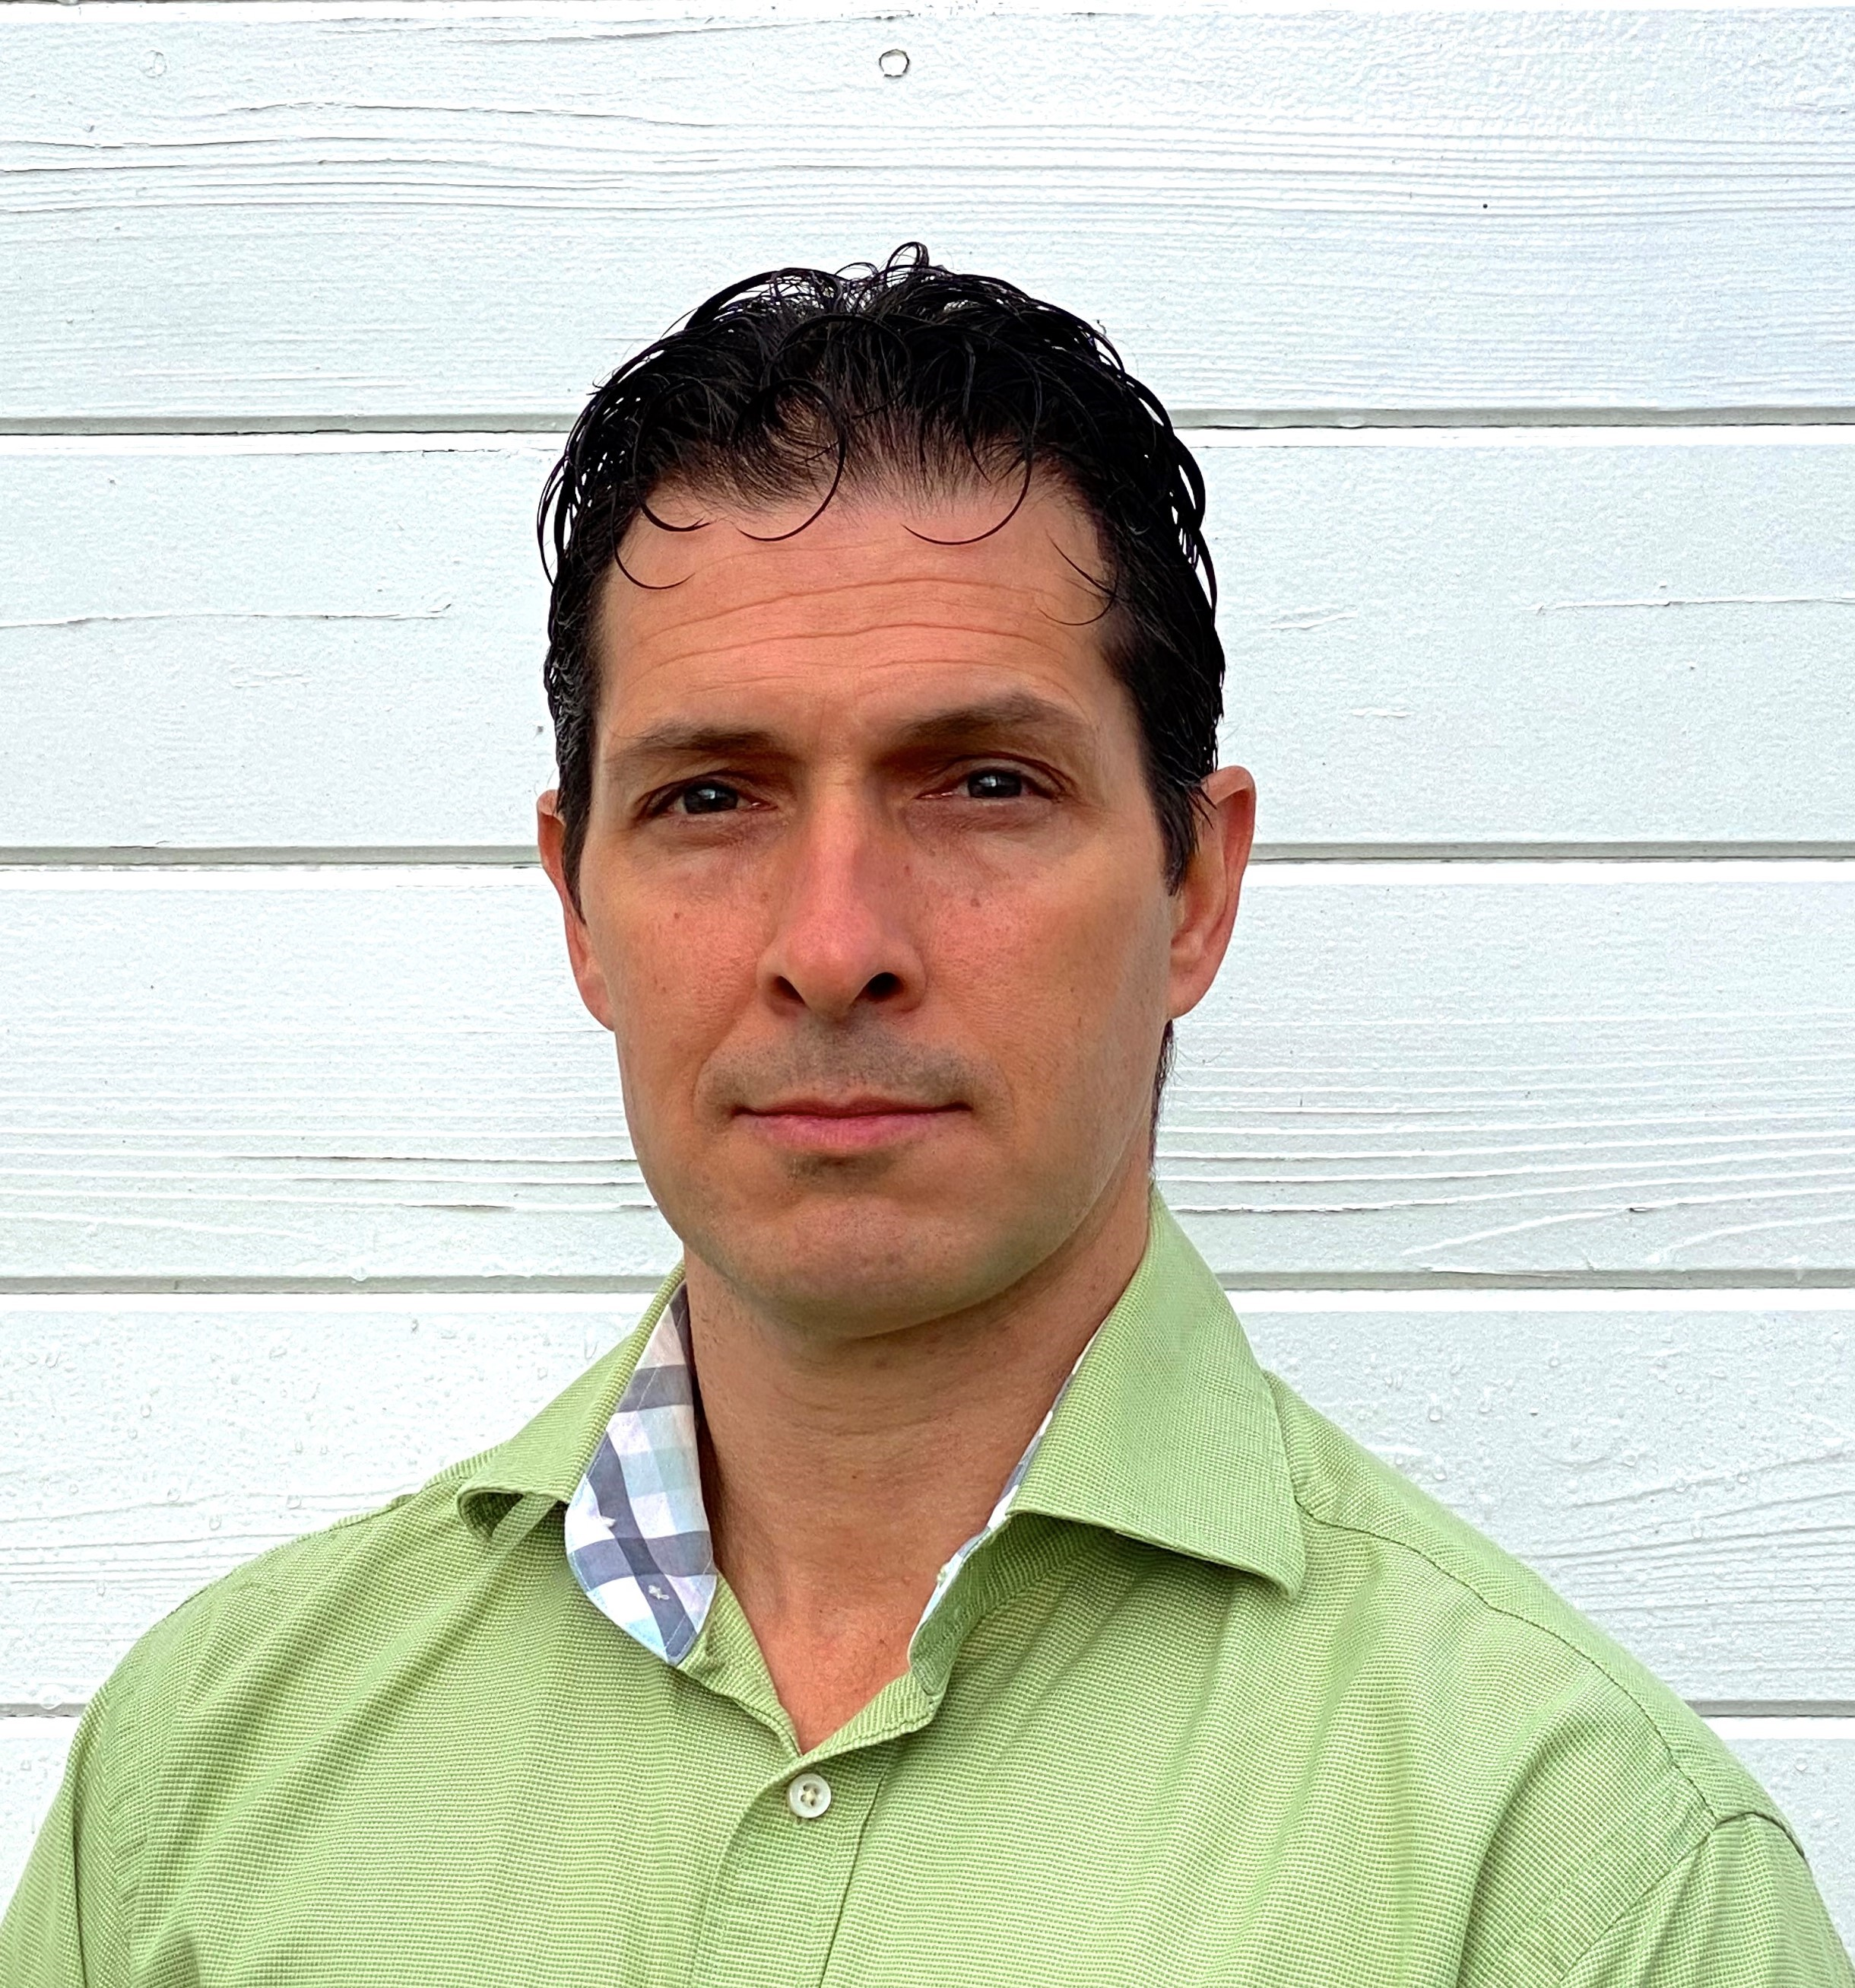
Aaron Foucheaux Consultant
Cloud & Product
Email
Aaron.Foucheaux@thebridge.com
Location
Seattle, WA
Mobile
(831) 566-4054
Aaron joined The Bridge in April 2024. He was previously working with Bridgeworks Consulting Group and his own LLC as a Full Stack Software Engineer.
Prior to his work in software development and has 20+ years of experience in retail management, operation, logistic and HR. Proven ability to utilize this knowledge base to provide real world client solutions.
EXPERIENCE
Industry Experience
Software Engineering | JavaScript | Typescript | C# | React | SQL | Retail | Operations | Logistics | HR
Full Stack Development | Construction Materials & Manufacturing.
Developer on Enterprise Production Tracking application:
Typescript/React Front End with Jotia state management and Telerik component library.
C# .NET Back End with Entity Framework.
SQL Server database
Azure DevOps & Azure App Services
Lead developer and support engineer on Customer Portal application:
Typescript/React Front End with Redux state management.
C# .NET Back End with Entity Framework.
SQL Server database management & query/database optimization.
Identity Server API authentication.
Other notable integrations include Payment Processor and Service Now.
Azure DevOps & Azure App Services
Developer on Manufacturing Plant Emissions Monitoring System.
Converted legacy VB6 application to .NET.
SQL Server database
PLC integration.
WinForms user interface.
Functional Skills
Software Design & Development, Front End Engineering, Backend Engineering, UI Design,
SQL, Query Optimization, DevOps, Project Management.
Qualifications
Proven track record of development and support of business-critical client application and systems.
BACKGROUND

